Slide 1
Advancing Esports Analytics: A Deep Learning Approach to Valorant Match Prediction Using CNN and LSTM
Group 14
Sanchit Kedia | Shantanu Parab | Tanmay Haldankar | Vineet Singh

Slide 2
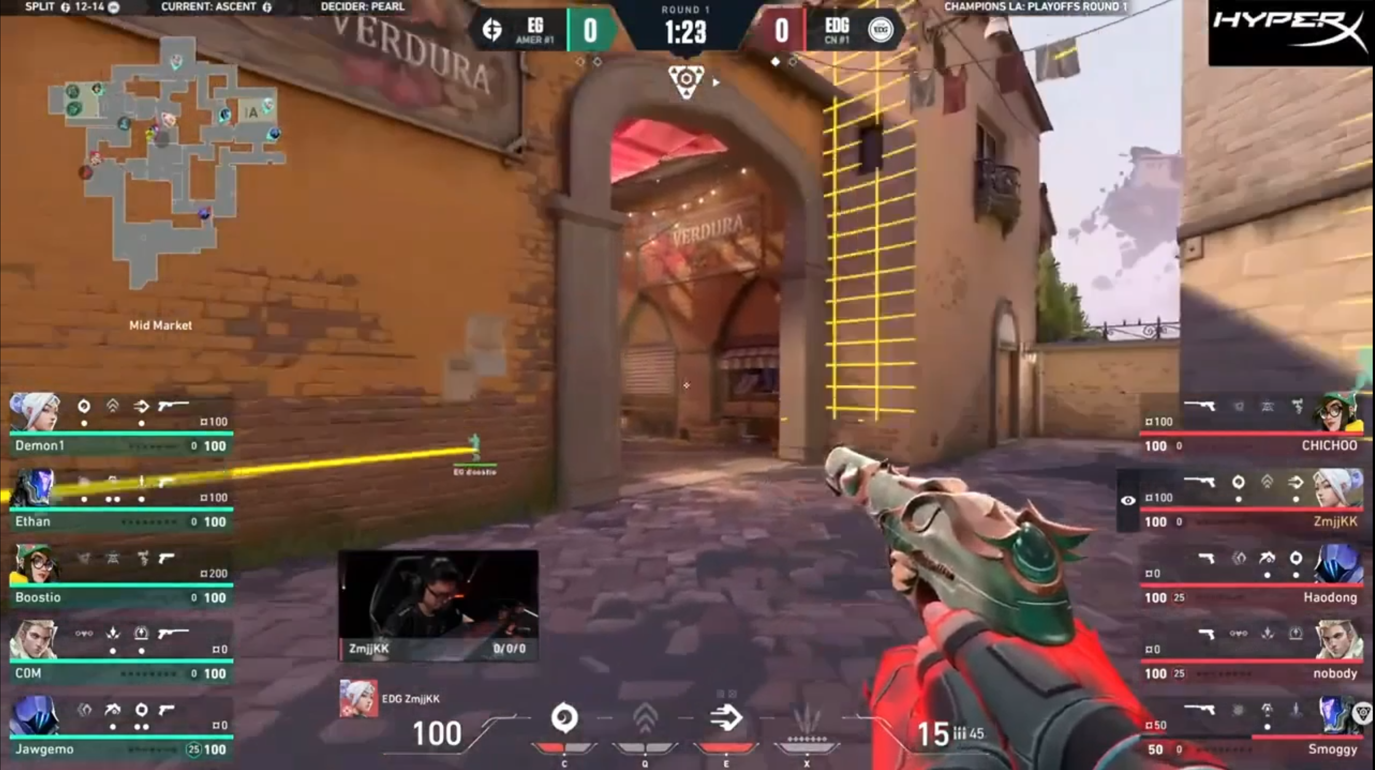

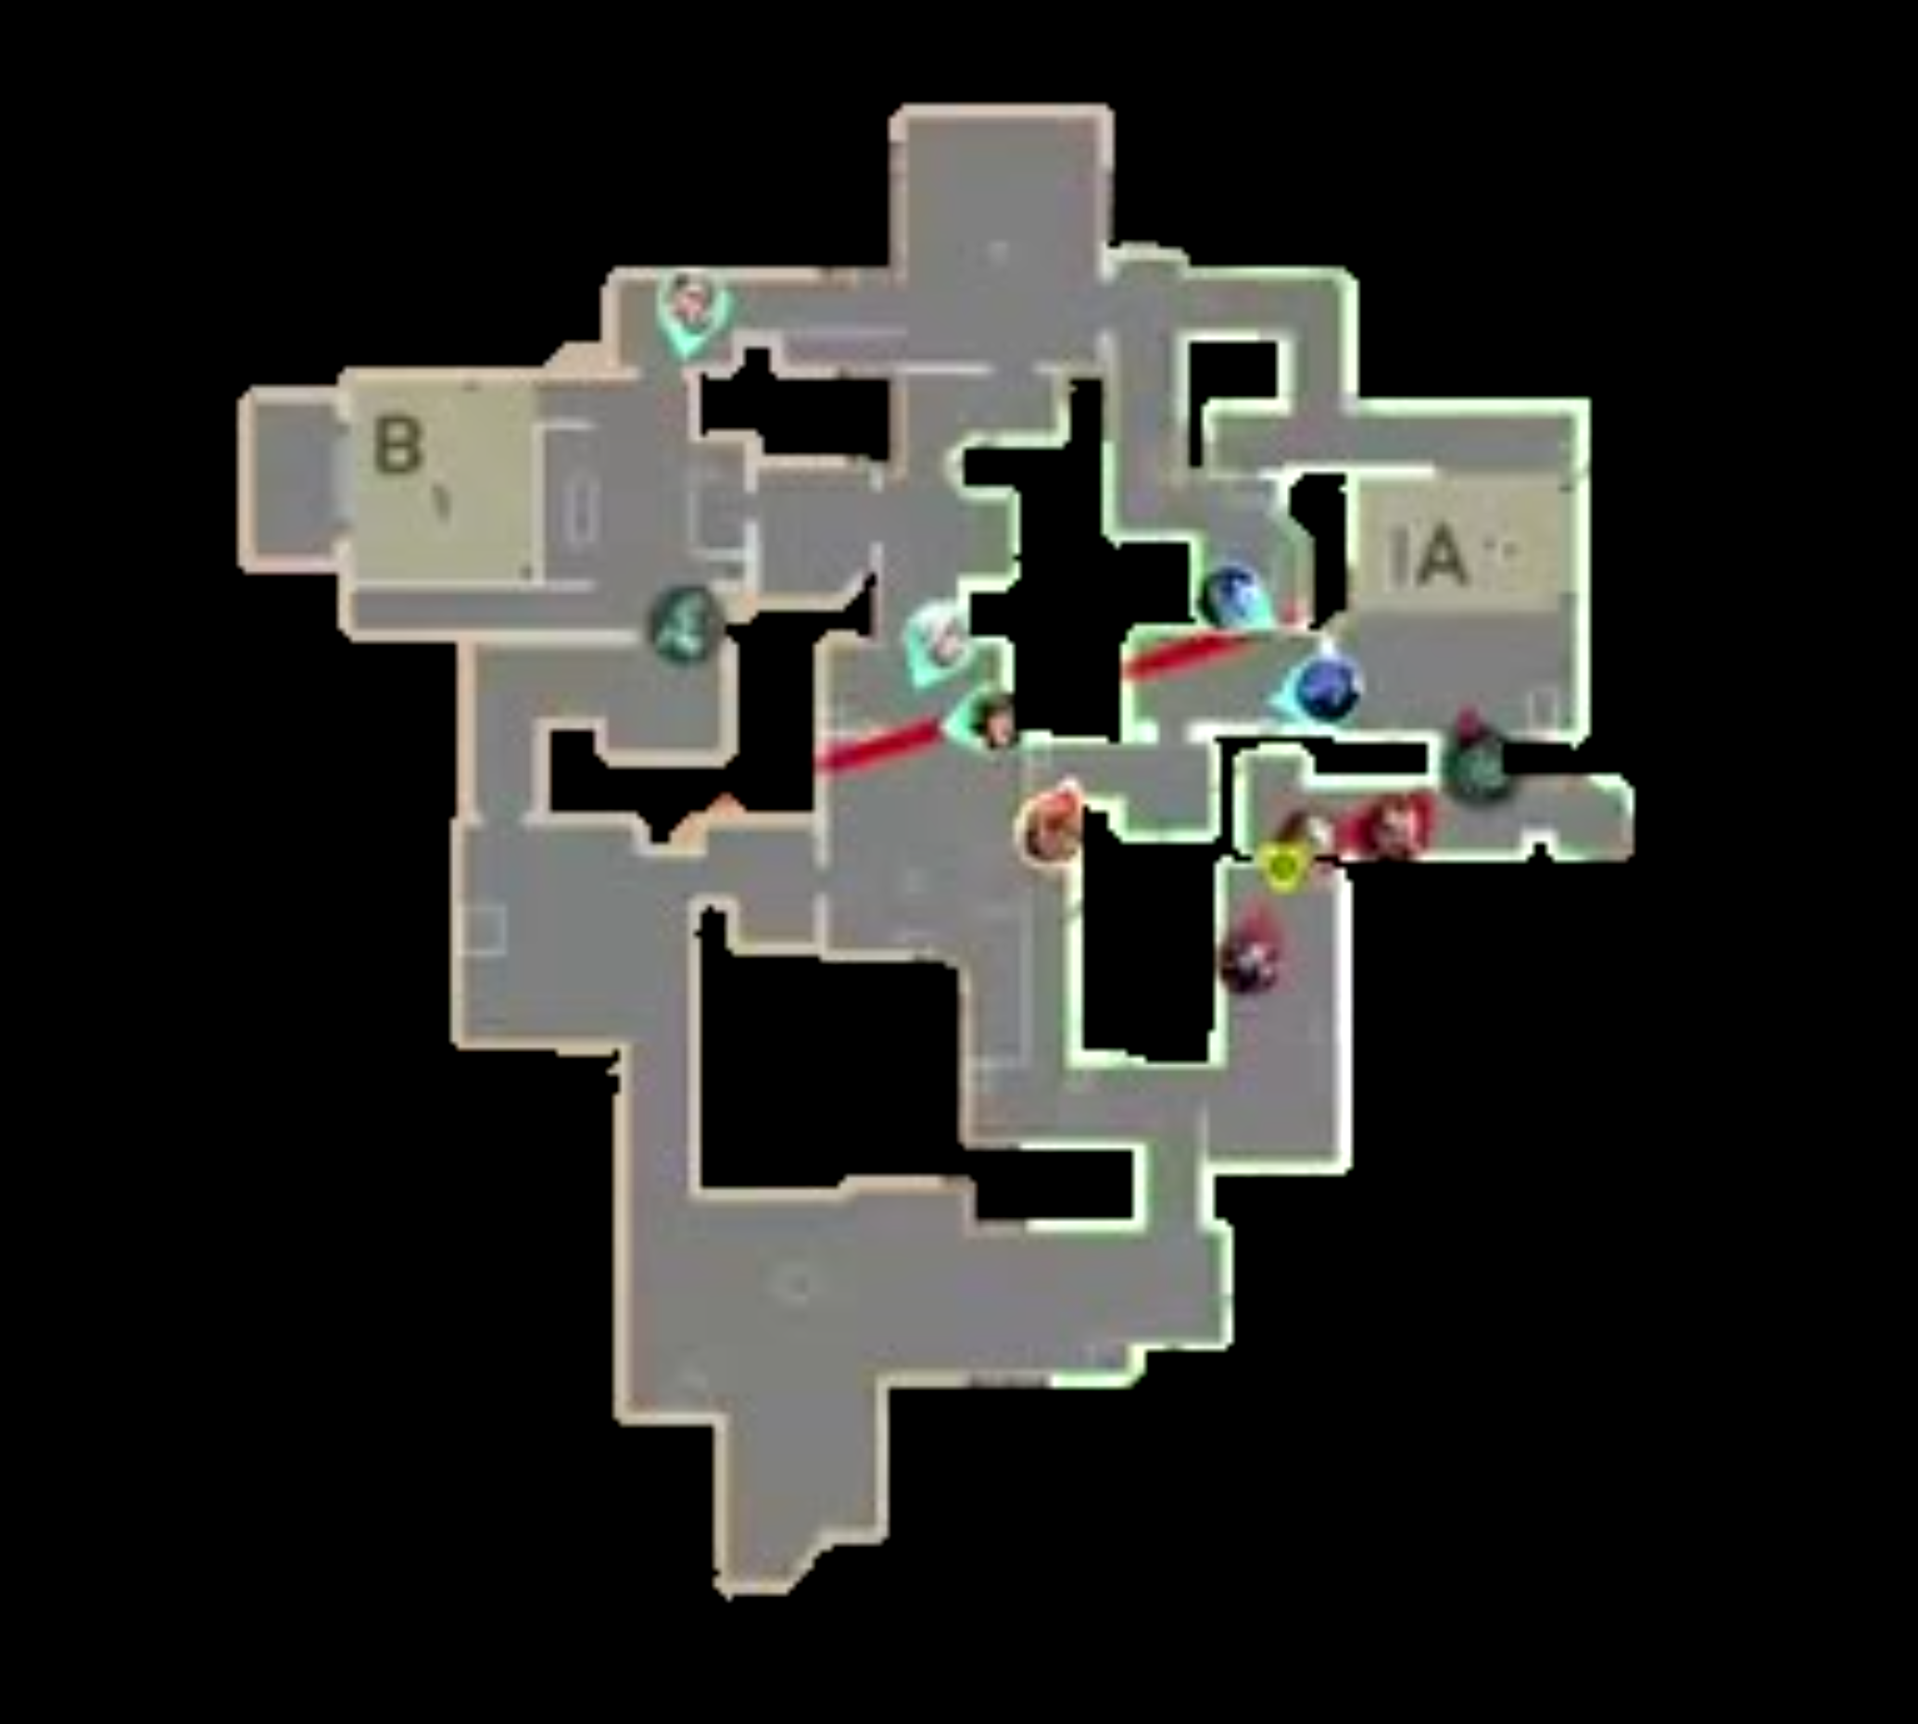
Problem Statement
Goal:
Explore the use of Convolutional Neural Networks (CNNs), Long Short-Term Memory (LSTM), and Gated Recurrent Unit (GRU) networks in predictive analytics in Esports.
Develop a model that can predict the outcome of a match in any e-sport by viewing the live broadcast of a game.
Motivation:
The E-sports industry has experienced remarkable growth, with soaring global viewership and revenue.
Sports prediction algorithms provide increased fan engagement, support for strategic decision-making, player performance analysis, application in sports betting platforms, and enhancement of sports broadcast and media coverage.

Slide 3
Techinical Challenges
Development of deep learning model for sports predictive algorithms is posed by several technical challenges
Complexity of Sports and Player-Team Dynamics
Interference of external factors
E-sports Meta Shifts
Esports Genre Variation
Video understanding tasks pose several challenges for deep learning models due to the inherent complexity of spatiotemporal data.
High Dimensionality
Temporal Dynamics
Variable-Length Sequences
Real-Time Constraints
Large Amounts of Data
Spatial and Temporal Variability
Combining Spatial and Temporal Features
Context Understanding
Notes:
High Dimensionality: Videos consist of a sequence of frames, and each frame is a high-dimensional image. The sheer volume of data in video sequences increases the complexity of the learning task compared to static images.
Temporal Dynamics:Videos capture temporal information, and understanding actions or events requires modeling the dynamics over time. Deep learning models need to effectively capture and learn temporal dependencies, which can be challenging compared to processing static snapshots.
Variable-Length Sequences:Videos can have variable-length sequences, and different actions or events may unfold over different time scales. Designing models that can handle sequences of varying lengths is a non-trivial task.
Real-Time Constraints: Some applications, such as video surveillance or autonomous vehicles, require real-time processing. Deep learning models for video understanding need to balance accuracy with computational efficiency to meet real-time constraints.
Large Amounts of Data: Training deep learning models for video understanding often requires large amounts of labeled data, which may be costly and time-consuming to acquire. Limited datasets can lead to overfitting, especially when dealing with complex tasks.
Spatial and Temporal Variability: Objects and scenes in videos can exhibit both spatial and temporal variability. Recognizing and generalizing patterns across different spatial and temporal scales is a challenge for deep learning models.
Combining Spatial and Temporal Features: Video understanding often involves combining spatial information (from individual frames) with temporal information (from the sequence of frames). Integrating these features effectively is crucial for accurate recognition and interpretation.
Context Understanding: Understanding the context of actions or events in a video is essential. Deep learning models need to capture contextual information, including relationships between objects, spatial layouts, and the broader scene context.

Slide 4
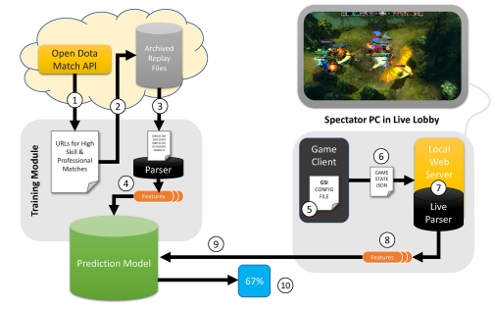
Related Works
Win Prediction in Multiplayer Esports: Live Professional Match Prediction
Victoria J. Hodge , Sam Devlin , Nick Sephton , Florian Block, Peter I. Cowling and Anders Drachen
Linear Regression
-------------------------
Random Forest
-------------------------
Gradient Boosting Framework
Use of Server logs
Notes:
4.

Slide 5
Related Works
Predicting game outcome in multiplayer online battle arena games
Seung-Jin Hong Sang-Kwang Lee and Seong-Il Yang. .
Machine learning models for dota 2 outcomes prediction
Kodirjon Akhmedov and Anh Huy Phan
Empirical evaluation of gated recurrent neural networks on sequence
KyungHyun Cho Junyoung Chung, Caglar Gulcehre and Yoshua Bengio.
Notes:
4.

Slide 6
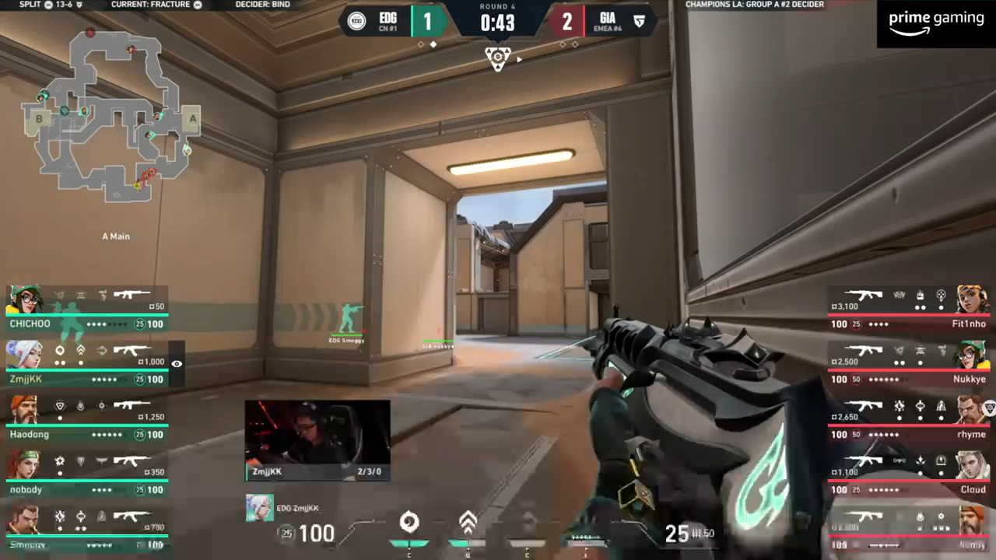
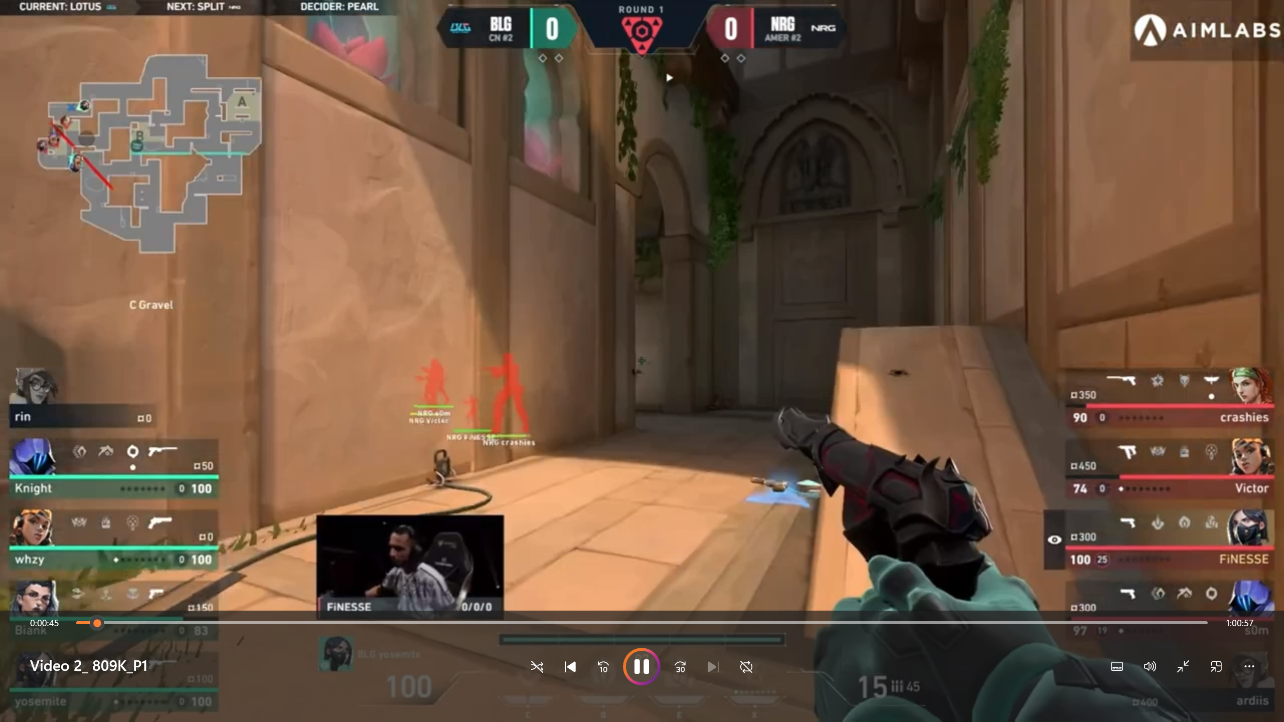
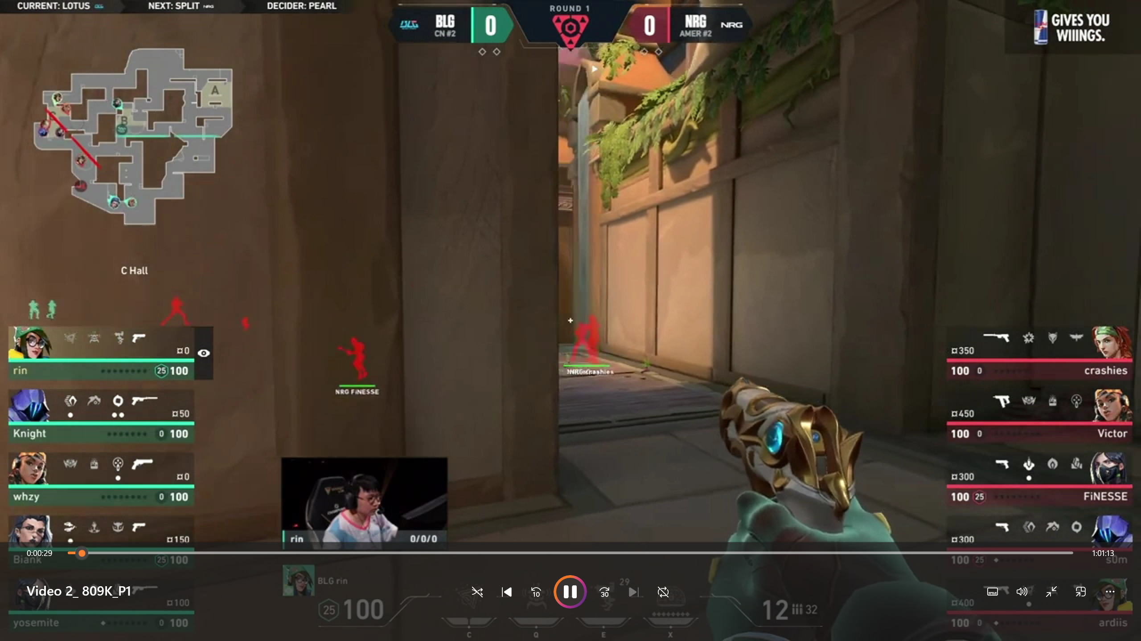
Dataset Collection
Sourced professional Valorant broadcast videos from YouTube, and gathered data from 12 videos covering 63 games.
Phase 1: Generated a dataset of 99,308 labelled frames.
Phase 2: Generated a dataset of 1259 labelled round-wise videos.
win
win
win
loss
loss
win
Notes:
We focused on footage from the most recent major international Valorant events, Valorant Champions 2023 and Valorant Masters Tokyo 2023.

Slide 7
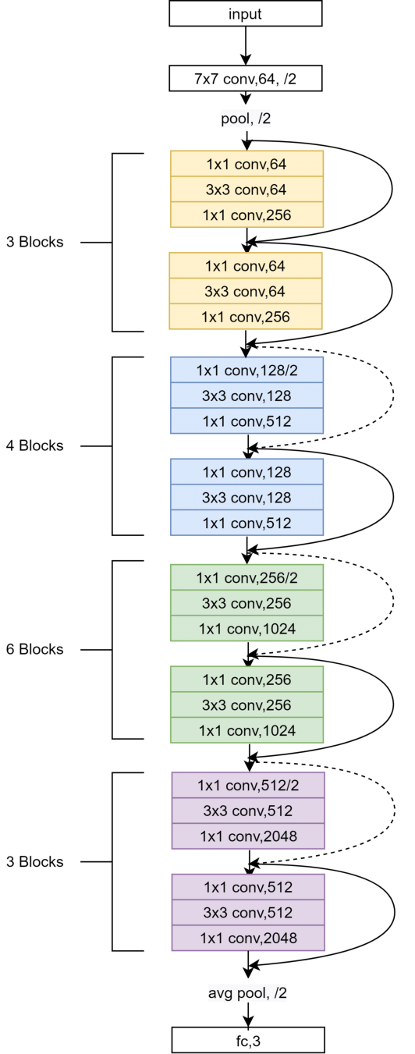
Model Architecture
Phase 1: Classify individual frames from videos and predict a score of confidence.
Model: ResNet-50
RESNET-50 MODEL
TRAINED
RESNET MODEL
win
win
loss
loss
TRAINED RESNET-50 MODEL
win
win
loss
loss

Slide 8
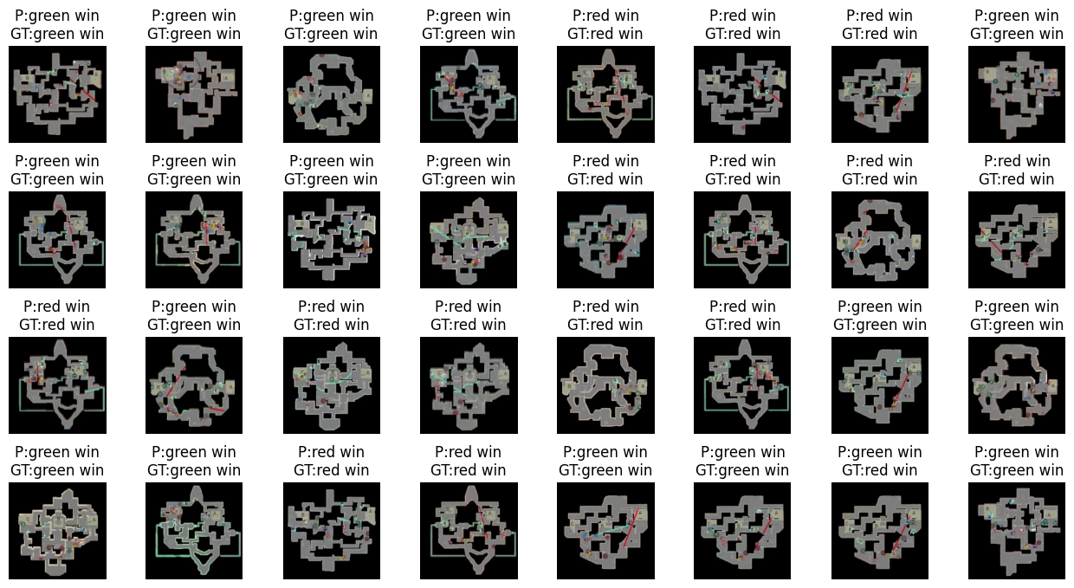
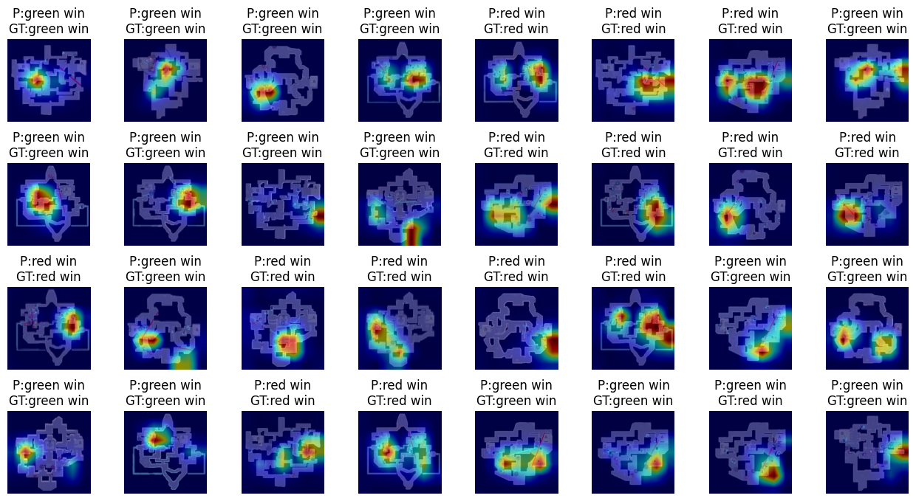
What CNN Learns?

Slide 9
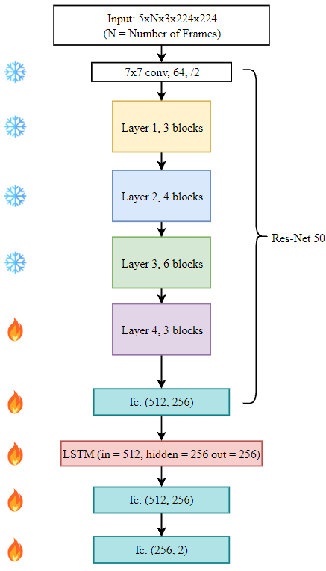
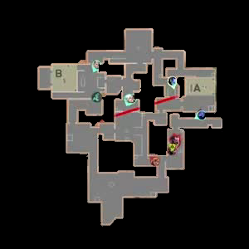
Model Architecture
Phase 2: Classify sequence of frames from videos and predict a score of confidence.
Model: ResNet-50 + LSTM/GRU
CNN+LSTM/GRU
Trained
CNN+LSTM/GRU
WIN
LOSS

Slide 10
Methodology
Stage-1 | Stage-2
Model: Res-Net50 | Model: LSTM/GRU + Res-Net50
Dataset: 99,308 labeled images | Dataset: 1259 labeled videos
Original frame size: 3x300x300 Data transform: Resize:256, Center Crop: 224 Normalize: mean=[0.485, 0.456, 0.406], std=[0.229, 0.224, 0.225] Transformed frame size: 3x224x224 | Original frame size: 3x300x300 Data transform: Resize:256, Center Crop: 224 Normalize: mean=[0.485, 0.456, 0.406], std=[0.229, 0.224, 0.225] Transformed frame size: 3x224x224
Input Dimensions (Training): 32x3x224x224 Input Dimensions (Evaluation): 3x224x224 | Input Dimensions (Training): 5xNx3x224x224 Input Dimensions (Evaluation): Nx224x224
Number of parameters to train: 58,147,906 | Number of parameters to train: 1,736,1794
Output Dimensions (Training): 32x2 Output Dimensions (Evaluation): 1x2 | Output Dimensions (Training): 5x2 Output Dimensions (Evaluation): 1x2
Evaluation metric: Accuracy | Evaluation metric: Accuracy
Loss Function: Cross Entropy loss | Loss Function: Cross Entropy loss
Optimizer: Adam | Optimizer: Adam (weight decay = 1e-3)
Hyper-Parameters | CNN | CNN+GRU | CNN+LSTM
Learning Rate | 0.001 | 0.001 | 0.001
Number of epochs | 10 | 10 | 10
Batch Size | 32 | 5 | 5
Table 2: Hyper Parameter Selection
Table 1 :Comparison of Stage 1 and Stage 2 Models

Slide 11
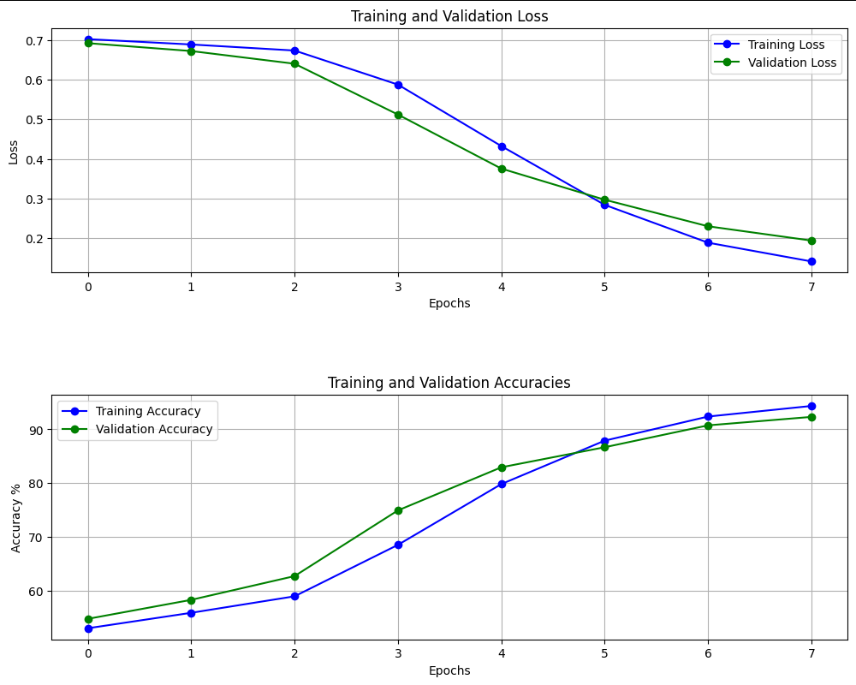
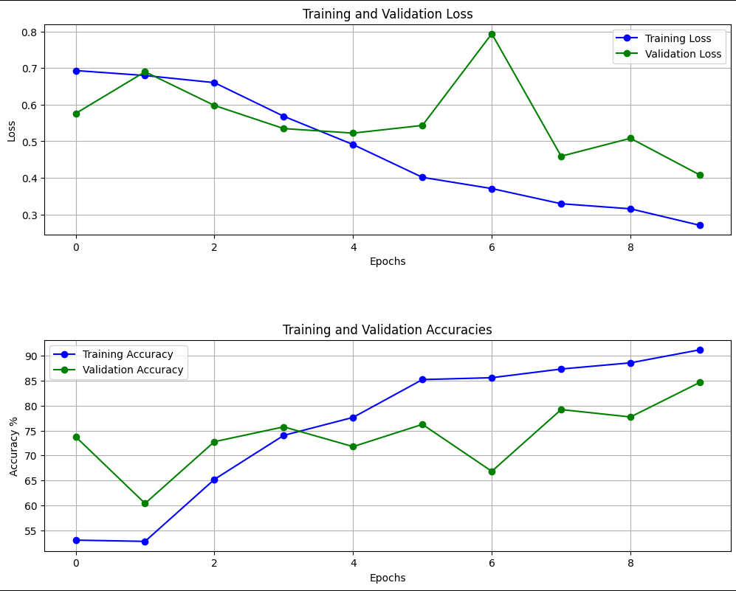
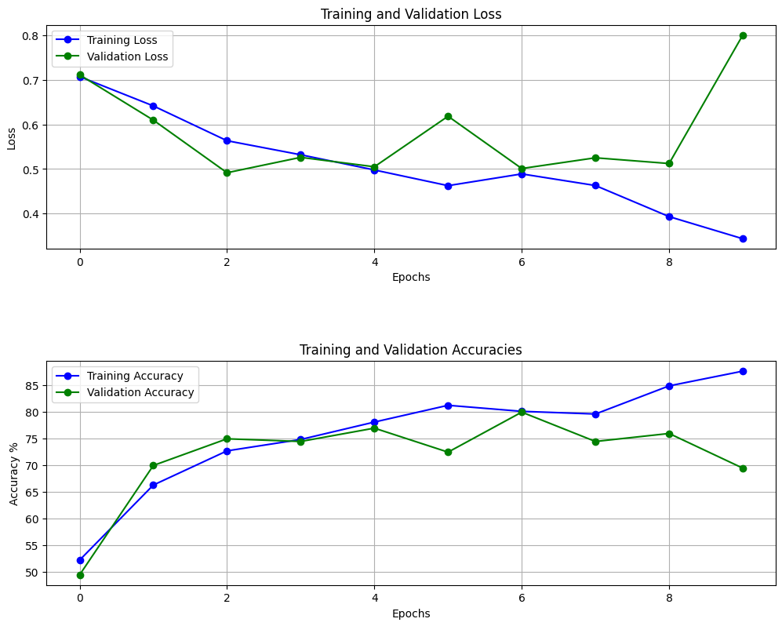
Results
Phase 1: CNN Training Graphs
Phase 2: CNN-LSTM Training Graphs
Phase 2: CNN-GRU Training Graphs
Accuracy | CNN | CNN+GRU | CNN+LSTM
Training | 94.35% | 85.00% | 91.18%
Validation | 92.32% | 76.00% | 84.65%
Testing | 92.55% | 73.55% | 80.05%

Slide 12
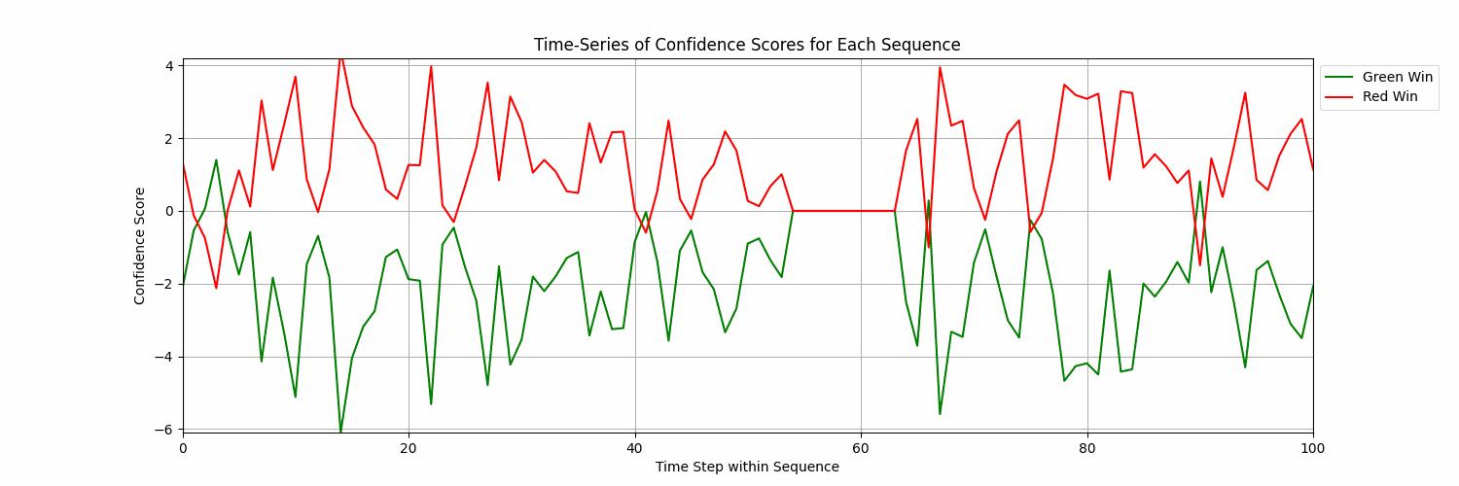
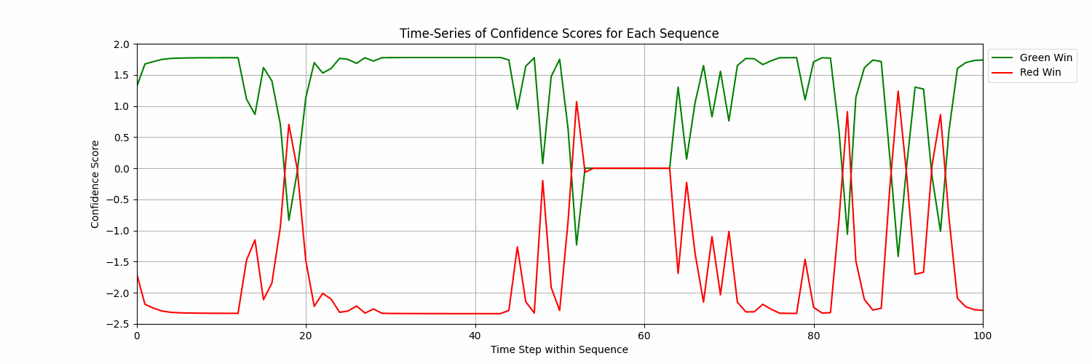
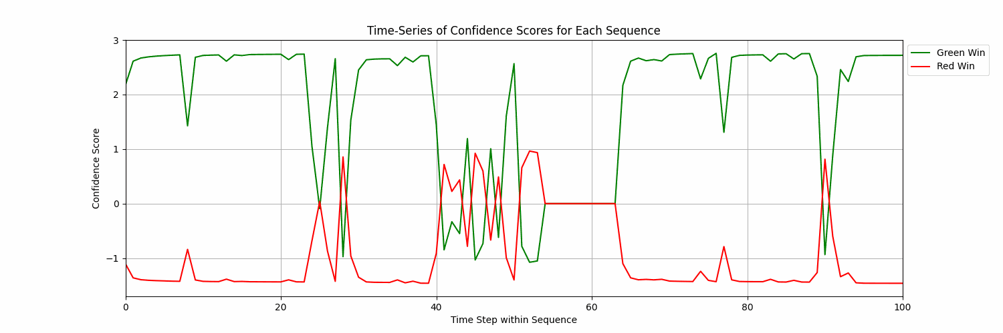
Results
CNN:
Accuracy | CNN | CNN+GRU | CNN+LSTM
Inference | 66% | 71% | 79%
CNN + LSTM:
CNN + GRU:

Slide 13
Broader Impact
Limitations:
Not utilizing all available information
Subpar video quality and masking imperfections
Inaccuracy in data collection
Challenges with real-time prediction
Frequent game updates
Impact:
Enhanced Esports Viewing Experience
Strategic Insights for Teams and Coaches
Informed Betting and Gambling
Statistical Insights for Valorant Developers
Data-Driven Esports Journalism

